Slide 1
CLAIMS MANAGEMENT
Machine Learning Project by
Riju Chatterjee
Ayan Ghorai
Debjit Adhikary
Subhodip Ghosh
Shreya Mallick

Slide 2
Overview of problem
What is claims Management and why to study it?
-> Claims Management means handling matters related to customers or third parties bringing a claim against a Party or claims by a Party against customers or third parties.
-> It mainly includes investigations, litigation support, and settlements.
-> Claim provision are crucial for the financial stability of insurance companies.
-> Faster approval of customer’s claim is very crucial for a company to get more customers in future.
-> For a company future prediction of insurance claim will be very helpful to serve customers a better service.
-> Insurance groups believes in Data Analytics to adopt the changing technologies to provide better facilities to their customers.

Slide 3
Overview of problem(Contd…)
About the Dataset used in the project…
This dataset has been taken from www.Kaggle.com
Provided an anonymized dataset containing both categorical and numeric variables with all string type variables are categorical. There are no ordinal variables.
The dataset has 131 features and there are about 1.1 lakh rows of customer.
Column names and values in the dataset are masked because of customer confidentiality.
The "target" column in the train data is the variable to predict. It is divided in ones and zeroes.
claims for which approval could be accelerated leading to faster payments → 1
claims for which additional information is required before approval → 0

Slide 4
Overview of problem(Contd…)
Understanding the problem:
In the Problem Statement of the dataset, it is clearly said to predict the target variable that claim for which approval can accelerate leading to faster payments or more additional information is required before approval.
For which we have to categorize the target into the certain group of ones or zeros.
So, it is undoubtedly a classification problem.
So, Here The classification problem is binomial type.

Slide 5
Overview of problem
Planning:
Data Description – Firstly we load the data to our code and displayed the columns, some data from data set, observe the null value counts.
EDA – Secondly, plot graph of each column w.r.t. target to see how the columns are influencing our target.
Data Cleaning – Thirdly, drop some columns not effecting our target. And handle Null values.
Data Pre-Processing – Lastly apply pre-processing to normalize our data and by Recursive Feature Elimination and Variance Inflation Factor reduced number of columns for final model build.
Model Building - Model building is the most important step in Machine Learning. We apply various models on our dataset and watch for best results.

Slide 6
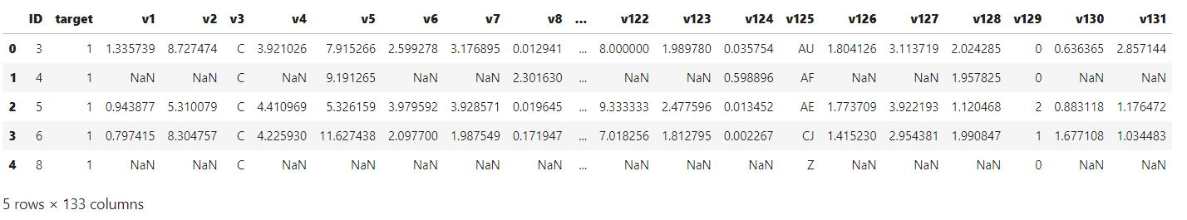
Overview of data
-> There are 114 numeric columns and 19 Object column.
Total 133 columns.
-> From the 114 numeric columns, 108 are of float type and 6 are discrete
-> short view of dataset
-> There are 102 columns having missing value percentage greater than 40.
-> It implies 76.69% of whole dataset contains missing values which is quite high.
-> Rest 23.31% of dataset is free of missing value which is quite low.

Slide 7
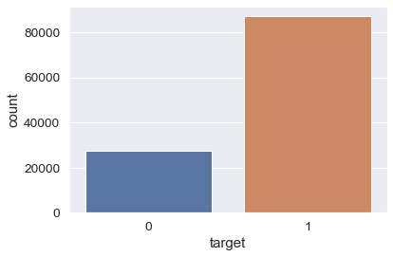
Exploratory Data Analysis
In our dataset among all the rows 76.12% target values are 1 and 23.88% target values are 0.
We explored the dataset to observe the different feature values and understand the data better.
For the float columns the values are normally distributed as well as contain a huge number of outliers. But as the values are normally distributed we can’t apply capping for them.
Based on some discrete columns count plot we drop them from our dataset for obvious reason as they are not effecting our model.
Images of different pyplots of float, int, object columns are shown in next slide.

Slide 8
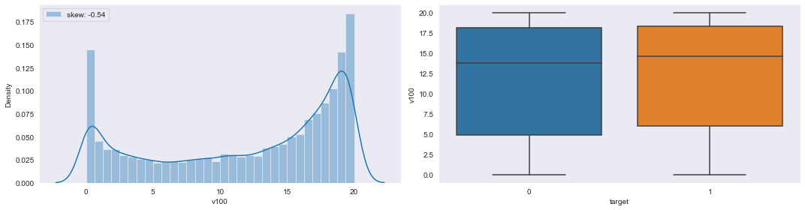
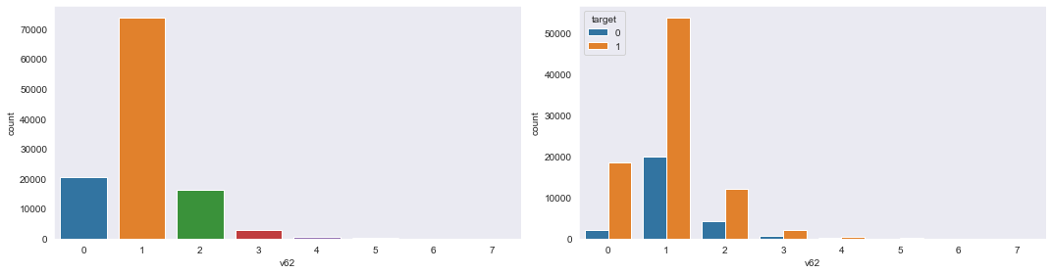
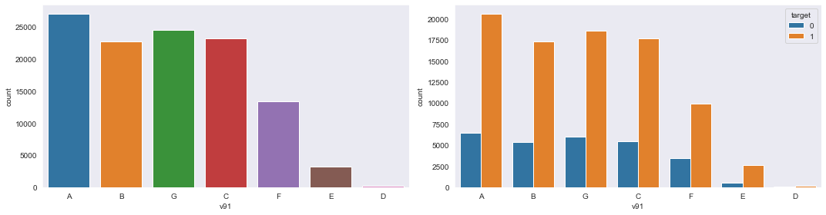
Exploratory Data Analysis(Contd…)
Data Analysis on Float Columns:
Data Analysis on Integer Columns:
Data Analysis on Object Columns:

Slide 9
Data Pre-Processing
There are different ways to do data pre-processing.
Data Cleaning: Removing duplicates, noise, filling in missing values, removing in consistency.
Data Integration: Merging data from different sources.
Data Transformation: Normalizing the data and aggregation of the required data.
Data Reduction: This technique is used when the data is expensive and time consuming.
Data Discretization: This is used when we want to break a continuous data into chunks of processing.
Feature Engineering: This technique is used to add new features based on correlation with the target variable.

Slide 10
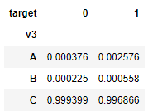
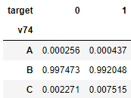
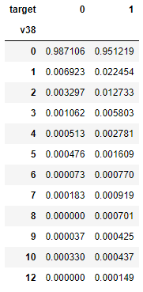
Data Cleaning
At first we drop “ID” for obvious reason.
Column v3:
A and B value counts are negligible compare
to C in v3. So, we drop “v3” column from data set.
Column v74:
A and C value counts are negligible compare
to B in v74. So, we drop “v74” column from data set.
Column v38:
Other value counts are negligible compare to
0 in v38. So, we drop “v38” column from data set.

Slide 11
Data Cleaning
Our dataset had huge number of missing values. These missing values were null. So we have two options, either we can remove all the records or we replace them with values.
But we can’t directly remove null values as it will effect our models, so we decided to replace them in two ways→
Float columns
we fill null values with mean.
While filling null values with mean we fill the null values corresponding to target value=0 with the mean of the values corresponding to target value=0
The null values corresponding to target value=1 with the mean of the values corresponding to target value=1.
Object columns and Int columns
We replace values with “Weight of Evidence” (woe) values and by filling the Null values with “missing” string for woe calculation.

Slide 12
Base Model Building
Base Model building is very important because based on this model
we will go for further feature reduction and try to improve scores of
our model.
For an insurance company a person not eligible for claim(0), if he/she is
approved for claim(1), this scenario is not intended. So we have to reduce the
number of “False +ve” cases.
So “Precision Score” is appropriate here and good accuracy should also be maintained.

Slide 13
Feature Selection
We use this technique to reduce number of features in our model. As too many features make the model unnecessarily complex and can cause overfitting to our model.
-> By RFE we reduce number of features reduced by 50% approximately to 60 features.
-> Now we find out vif and p>IzI values and we observe them to select the useless columns and again we remove them recursively to get all the vif values<5 and p>IzI values <0.05.
-> Finally we selected 26 features for our final model.

Slide 14
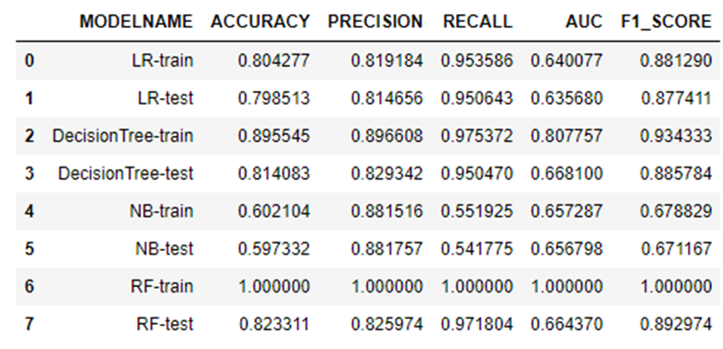
Conclusion
Above table represents scores of various models used.
Now by observing the scores we can see that
the Random Forest model is overfitted.
Naïve Bayes Model gives the worse result.
And Decision Tree model gives the best result.

Slide 15
Final Accepted Model
The ML algorithm that performs the best was Decision Tree model with
accuracy score:0.814
precision score 0.829
Recall score: 0.95
AUC score: 0.668
f1_score 0.885 with 26 selected features.
The 26 selected columns that are the part of model are ‘v12’, ‘v16’, ‘v19’, ‘v21’, ‘v22’, ‘v24’, ‘v28’, ‘v30’, ‘v36’, ‘v40’, ‘v50’, ‘v52’, ‘v56’, ‘v62’, ‘v66’, ‘v70’, ‘v72’, ‘v75’, ‘v78’, ‘v79’, ‘v112’, ‘v113’, ‘v117’, ‘v123’, ‘v125’, ‘v129’.

Slide 16
Future Scope of Improvements
Our given data set contains very large amount pf null value in it. And the given values of columns are having very large number of outliers but as the values are normally distributed we can’t remove outliers for building model. If the given data set contains less null values then the output of our project would be better.
So if we get some good data set with less outliers then there will be a huge difference in scores of our project.
The result could be better if we used Neural Network in our project.

Slide 17
Reference
We have taken reference from these website:
https://www.kaggle.com/
https://data-flair.training/blogs/machine-learning-project-ideas/
https://scikit-learn.org/stable/
https://pandas.pydata.org/
https://numpy.org/
https://scikit-learn.org/stable/modules/generated/sklearn.feature_selection.RFE.html
https://towardsdatascience.com/model-or-do-you-mean-weight-of-evidence-woe-and-information-value-iv-331499f6fc2
https://serokell.io/blog/machine-learning-project-ideas

Slide 18
Thank You

